Slide 1
FMCG Sales Performance, Promotion & Demand Forecasting
DATA ANALYST PORTFOLIO PROJECT
Nguyễn Thiên Hào

Slide 2
Business Problem
A demand-planning and commercial analytics team at an FMCG company needs to answer four questions:
Performance
Promotion
Which categories, brands, channels and regions drive sales, and how is the trend developing year over year?
Do promotions generate incremental volume, or do they mostly discount sales that would have happened anyway?
Availability
Planning
Where are we losing sales to stock-outs, and how does delivery lead time relate to this?
Can we forecast weekly demand accurately enough to reduce both stock-outs and overstock?

Slide 3
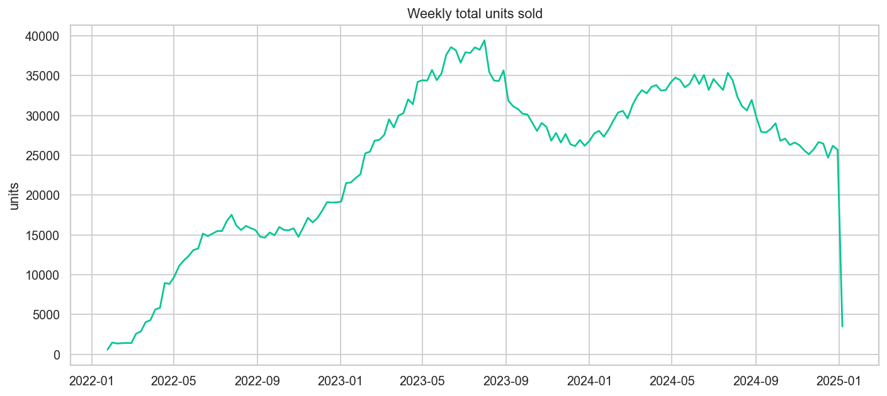
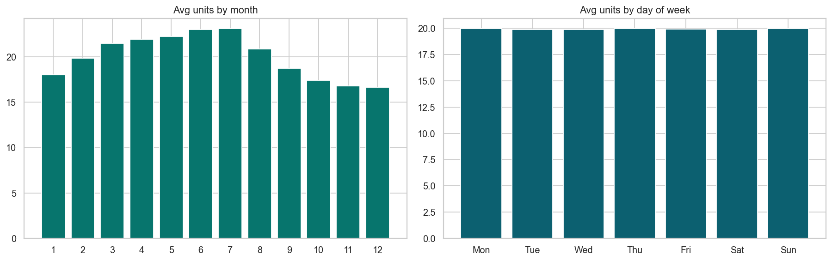
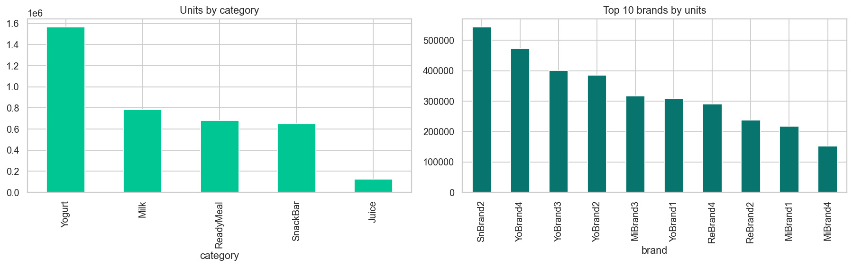
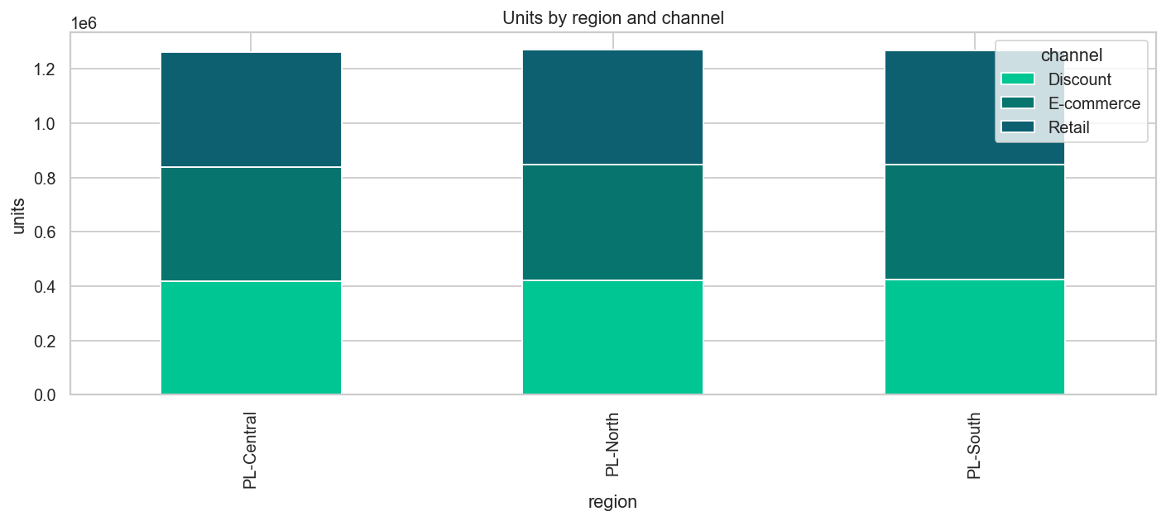
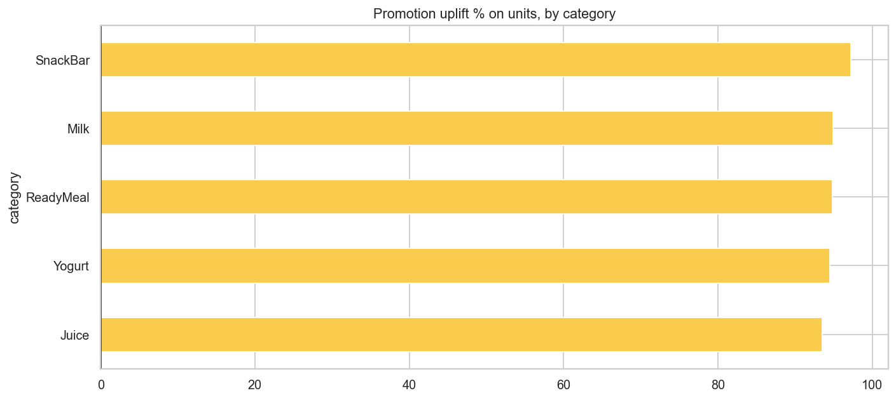
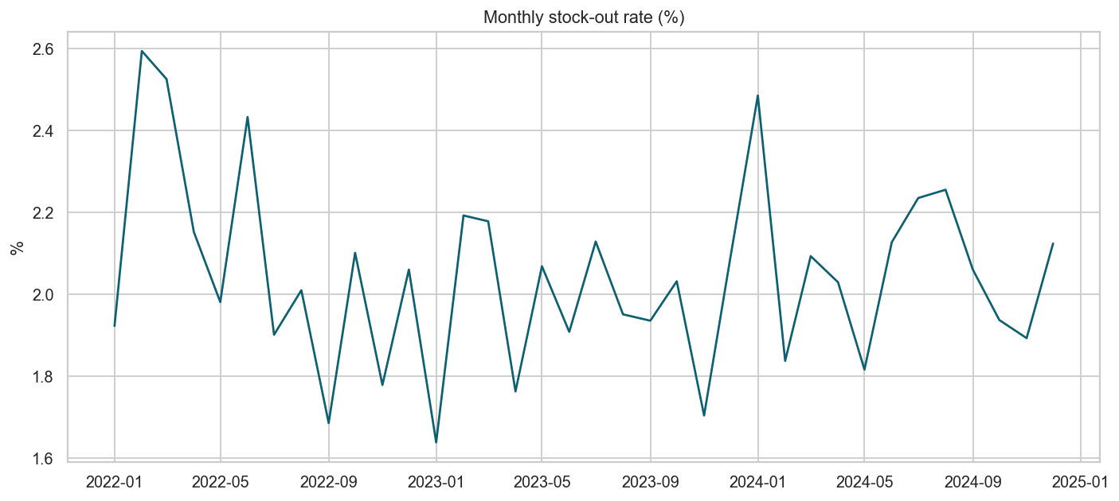
Analysis
01
Trend
02
Seasonality
03
Product Hierarchy
Weekly & YoY volume
YoY & Day of week
Category share, top brands, SKU
04
Channel & Region
05
Promotion
06
Stock-out
Volume mix
Uplift on volume, by category
Rate by dimension & over time

Slide 4
Insight 01 – Trend
Volume is flat YoY once the ramp is excluded.
3.80M
Total Units Sold
−0.9%
2024 vs 2023
30–35k
Weekly range in 2024
Ramp-up through 2022 as SKUs were onboarded, then a plateau from 2023
In year 2024 runs in a 30–35k weekly band after the mid-2023 peak near 39k
The +165% “2023 vs 2022” is an artifact of a partial ramp-up year in 2022 and is not treated as growth.

Slide 5
Insight 02 - Seasonality
Demand is strongly seasonal by month, not by weekday.
40%
Peak to trough swing in avg monthly units
Jun–Jul
Peak months, Nov–Dec is the trough
20
Avg units on every weekday
Monthly profile climbs to a Jun–Jul peak, then falls to a Nov–Dec trough
Weekday profile is flat at 20 units
Plan capacity and promo calendars by month; day-of-week carries no usable signal.

Slide 6
Insight 03 - Product Hierarchy
The portfolio is concentrated in a few categories and SKUs.
41.2%
Total volume comes from Yogurt alone
23 of 30
SKUs drive 80% of volume
7 SKUs
Low-volume
Yogurt dominates at 1.56M units, Juice is marginal at 0.12M
Top brands are SnBrand2, YoBrand4 and YoBrand3
Focus forecasting effort and shelf space on the head of the range, review the tail for delisting.

Slide 7
Insight 04 - Channel & Region
Region and channel are evenly balanced.
1.26M
Units per region, volume is split almost equally
3
Channels with similar volume shares
Low
Geography adds little signal in this dataset
All three regions land at about 1.26M units
Discount, E-commerce and Retail split each region in similar proportions
A dedicated region-comparison view is not warranted, prioritise category and promo drivers instead.

Slide 8
Insight 05 - Promotion
Promotions roughly double volume, consistently across categories.
+95.3%
Overall volume uplift on promoted rows
14.9%
Share of rows that are promoted
93–97%
Uplift range across all 5 categories
Uplift sits in a narrow 93–97% band across all five categories
SnackBar is highest at 97%, Juice lowest at 93%
Validate against real promo-cost and margin data.

Slide 9
Insight 06 - Stock-out
Availability is healthy and stable , no upward stock-out trend.
2.0%
Stock-out rate overall, flat over time
Nearly all
Zero-sales rows occur when stock_available = 0
No trend
Rate is stable across dimensions and periods
Monthly rate oscillates in a 1.6–2.6% range with no upward drift
Spikes read as noise, not deterioration, availability is under control
Availability is not the binding constraint, lost-sales upside is capped at the 2% out-of-stock rows.

Slide 10
Recommendations
1
Plan supply to the summer peak
The 40% Jun–Jul swing is the dominant planning signal, build inventory ahead of Q2-end.
2
Forcus S&OP on the core 23 SKUs
They carry 80% of volume, Yogurt first. Review the 7 tail SKUs for rationalisation or targeted support.
3
Treat promotions as a lever
Promos roughly double units, so guarantee stock cover on promo weeks, but validate ROI with margin and cost data before raising the 14.9% frequency.
4
Hold availability at 2%, targeted not blanket
Address the specific channel × region cells with the highest stock-out rate instead of adding blanket safety stock.
5
Forecast weekly at SKU
Annual seasonality plus a promotion regressor, exclude day-of-week.

